Slide 1


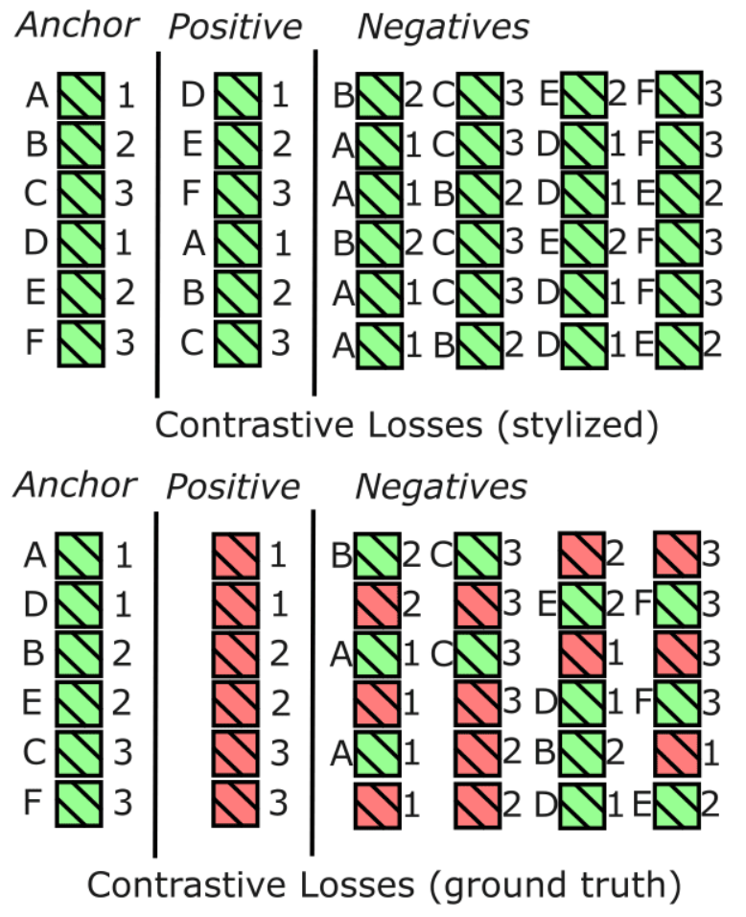
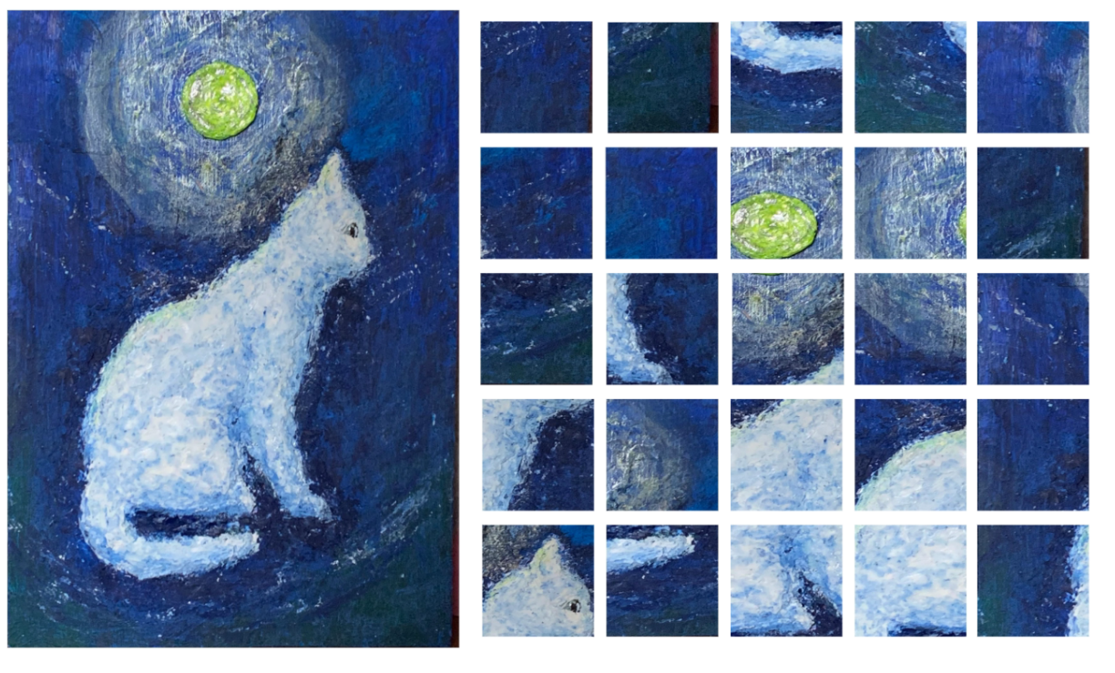
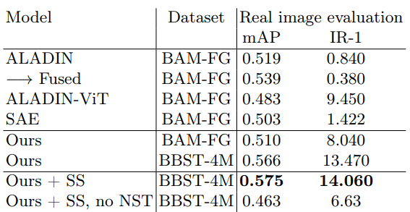
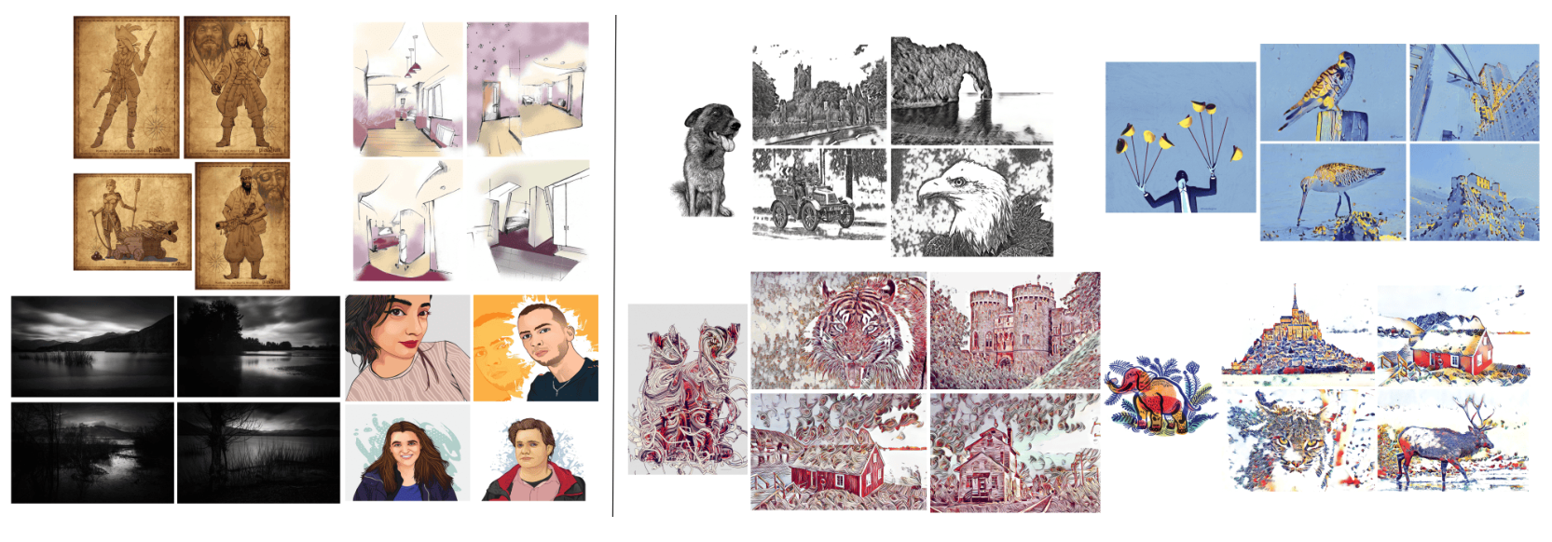
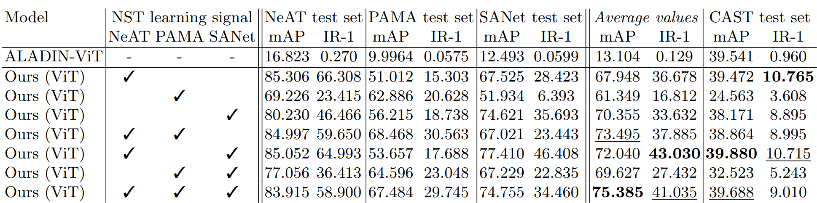
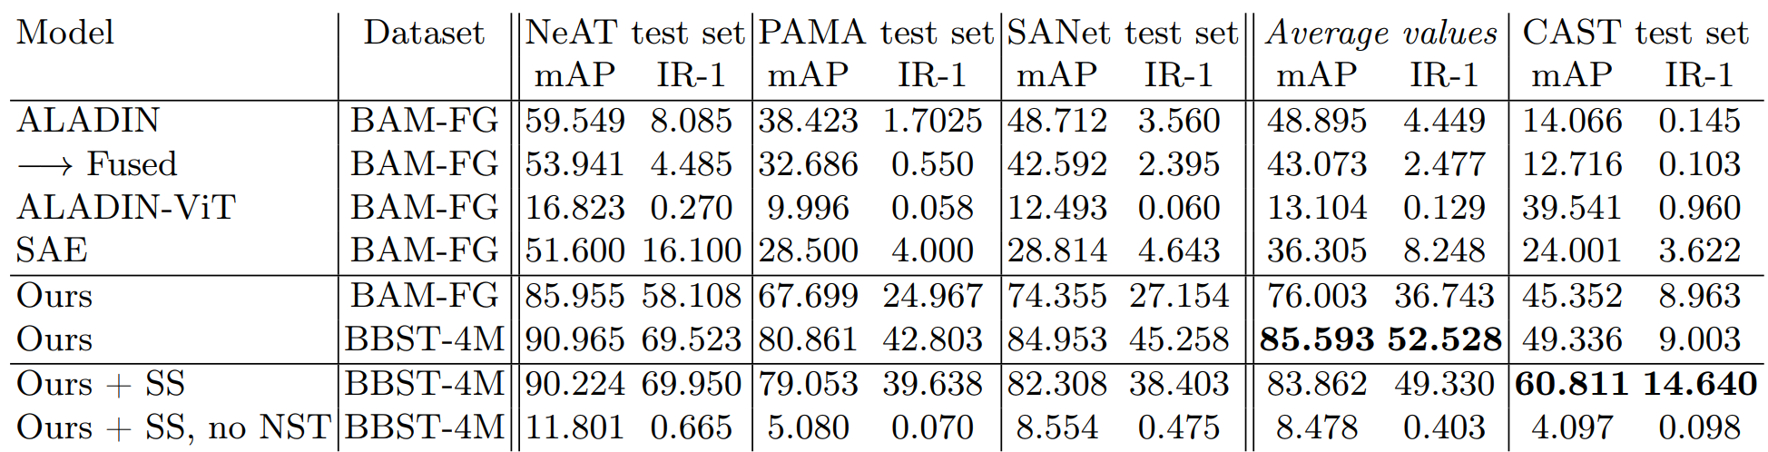
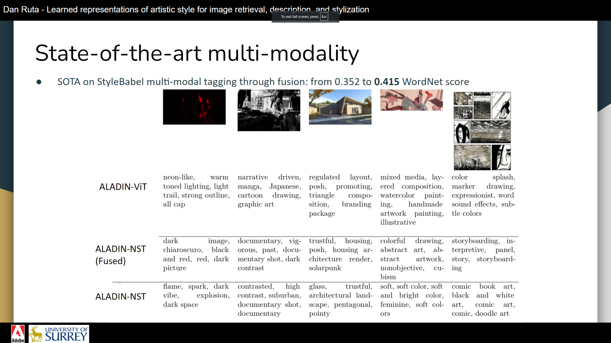
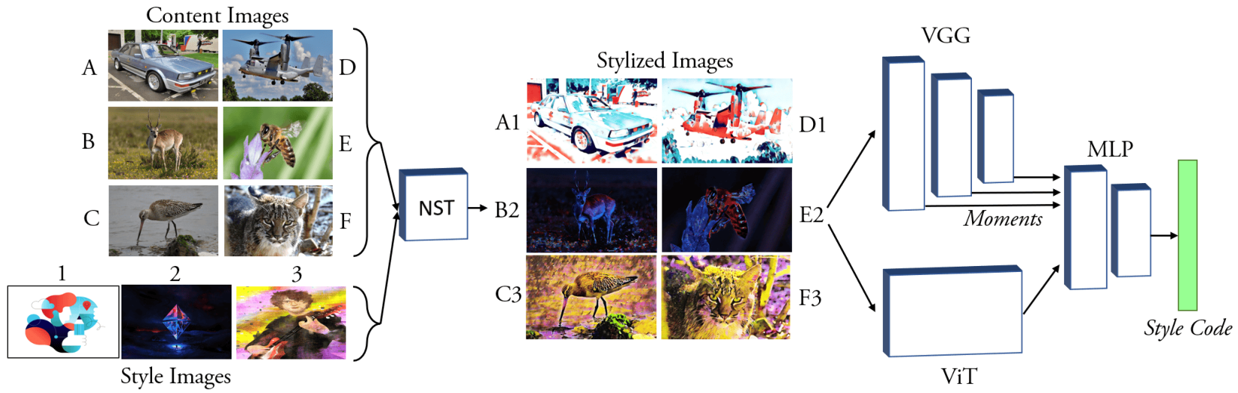
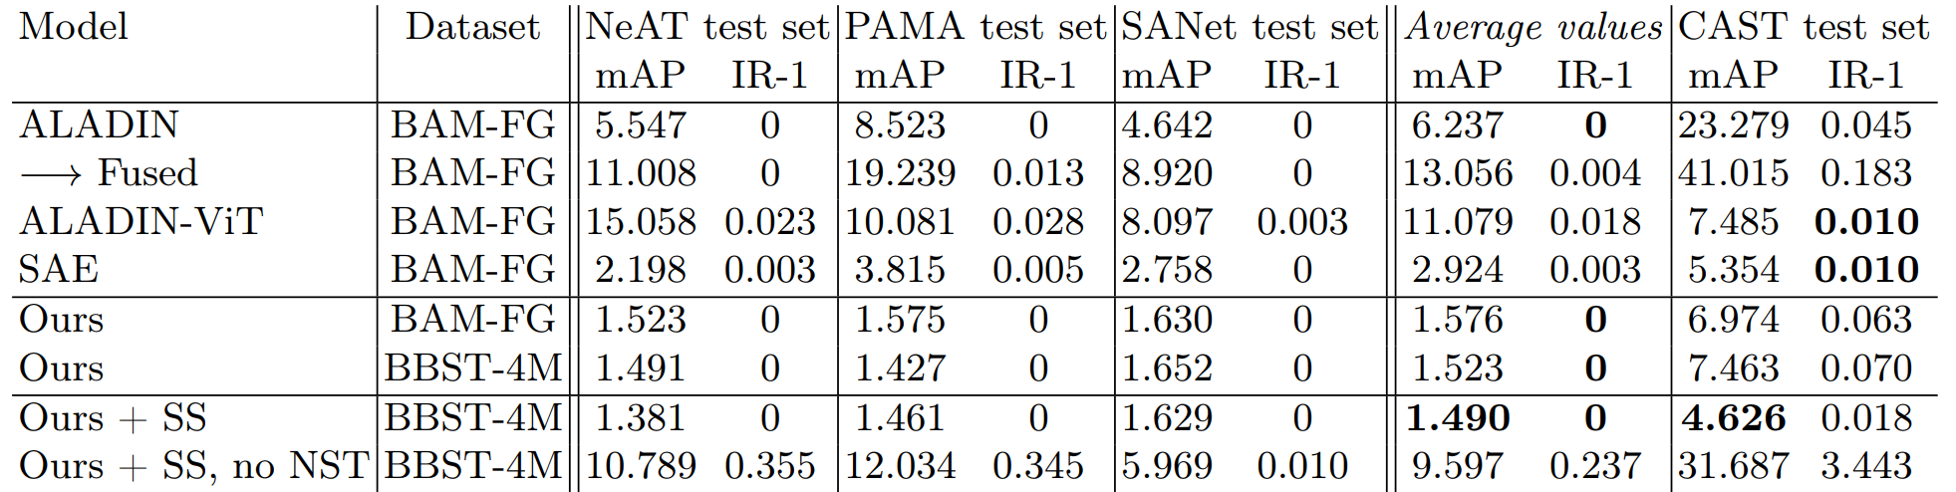
Self-supervised disentangled representation learning of artistic style through Neural Style Transfer ¹Dan Ruta, ¹Gemma Canet Tarrés, ¹Alexander Black, ¹Andrew Gilbert, ^{1,2}John Collomosse ¹CVSSP University of Surrey, ²Adobe Research
Background:
We set out to create a style representation learning model with far less entanglement of content information. We use Neural Style Transfer (NST) to measure and drive the learning signal and achieve state-of-the-art representation learning on explicitly disentangled metrics. We show that strongly addressing the disentanglement of style and content leads to large gains in style-specific metrics, encoding far less semantic information and achieving state-of-the-art accuracy in downstream style matching (retrieval) and zero-shot style tagging tasks
Contribution #1 - Novel training methodology for representation learning of style:
We use NST dynamically during the training process to generate style-consisted data with randomized content subject matter
We create invariance to the content, while training for style consistency
We use two branches in our model:
A descriptive ViT branch with global attention
A VGG branch over which we can compute moment statistics, for all layers, similar to the original ALADIN design
We also test with non-synthetic data, by first cropping high resolution data into smaller crops. This cropping breaks apart semantic content, slightly avoiding entanglement in the data
Contribution #2 - SOTA style representation learning with enforced disentanglement:
We achieve state-of-the-art style entanglement, as measured through image retrieval metrics
Our method does not encode content information as well, also as measured through image retrieval, but over content images
Contribution #3 - SOTA multi-modal vision/language representation learning of artistic style
We can use our model in downstream tasks such as multimodal vision/language representation learning - again in the domain of artistic style
By itself, our model does not achieve SOTA on the StyleBabel test set - we hypothesize this is due to entanglement in the StyleBabel data itself
We do achieve SOTA when fusing our model with ALADIN-ViT, the previous SOTA method on StyleBabel, inspired by experiments in the paper of the original ALADIN model
We use contrastive learning over positive data pairs of similar styles within a batch, amongst stylized results
The negative samples are the other remaining samples stylized in that batch
We also use the original style images as positives
We still compare favourably, even when evaluating with non-synthetic data. The gaps are smaller, as there is still some content/style entanglement, despite the cropping.
BAM-FG
Synthetic
Tested through style image retrieval on synthetic test created with several methods. We ablate the NST methods used during training. We include a hold-out NST method as test set (CAST)
Style image retrieval compared to baselines - higher value is better
Content image retrieval compared to baselines - lower value is better, to show the lack of learning content image features.

